Slide 1
PROG6212 – Programming 2B POE Contract Monthly Claim System (CMCS) - Part 3
Improvements and Enhancements Based on Feedback
ST10446648
Orearabetse Riba
21/11/2025

Slide 2

Overview of Part 3 Updates
Database integration (SQL Server)
HR Portal implementation
Lecturer View with integrated document upload
Coordinator & Manager dashboards
UI/UX improvements
Error handling enhancements

Slide 3
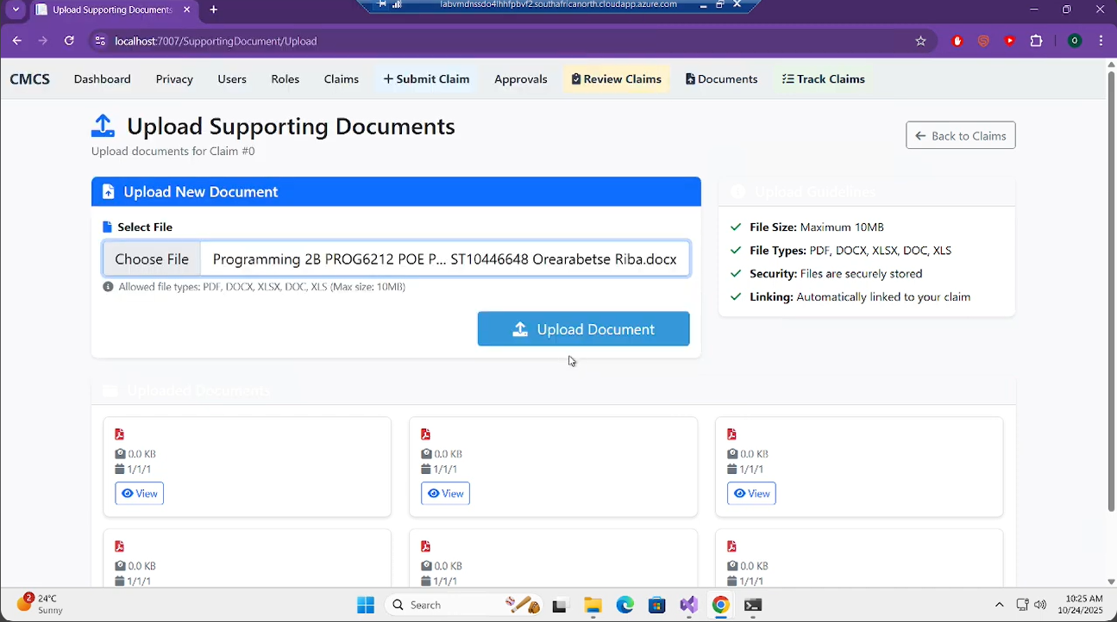
Addressing Part 2 Feedback
Feedback 1: "Document upload should be part of the claim form" → FIXED
Before:

Slide 4
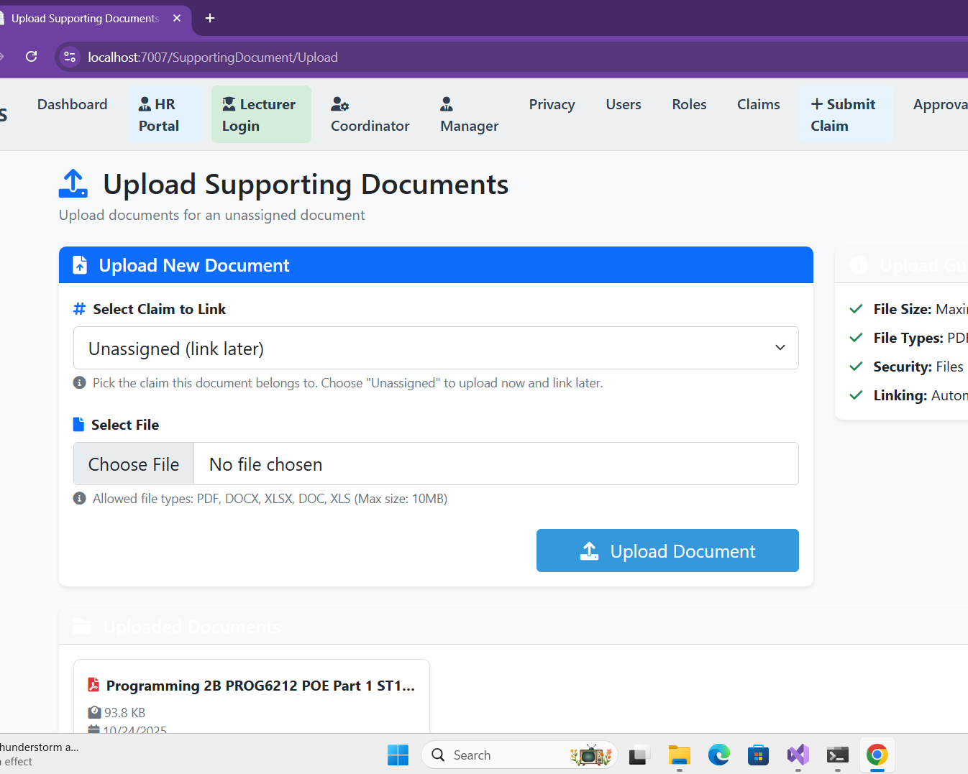
Addressing Part 2 Feedback
Feedback 1: "Document upload should be part of the claim form" → FIXED
After:

Slide 5
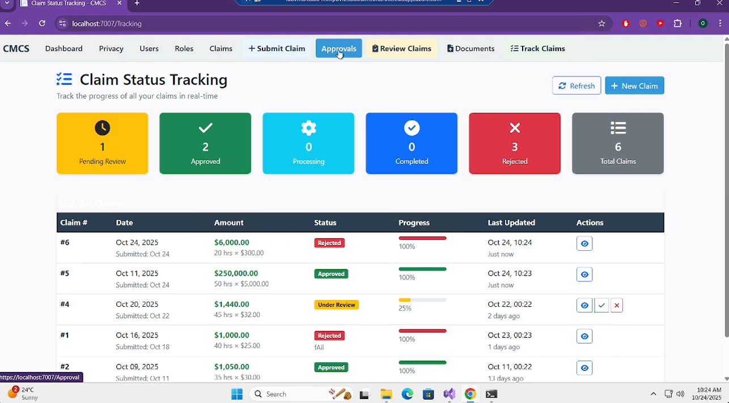
Addressing Part 2 Feedback
Feedback 2: Error handling (8/10) → IMPROVED
Feedback 3: Claim status tracking (8/10) → ENHANCED
Before:

Slide 6
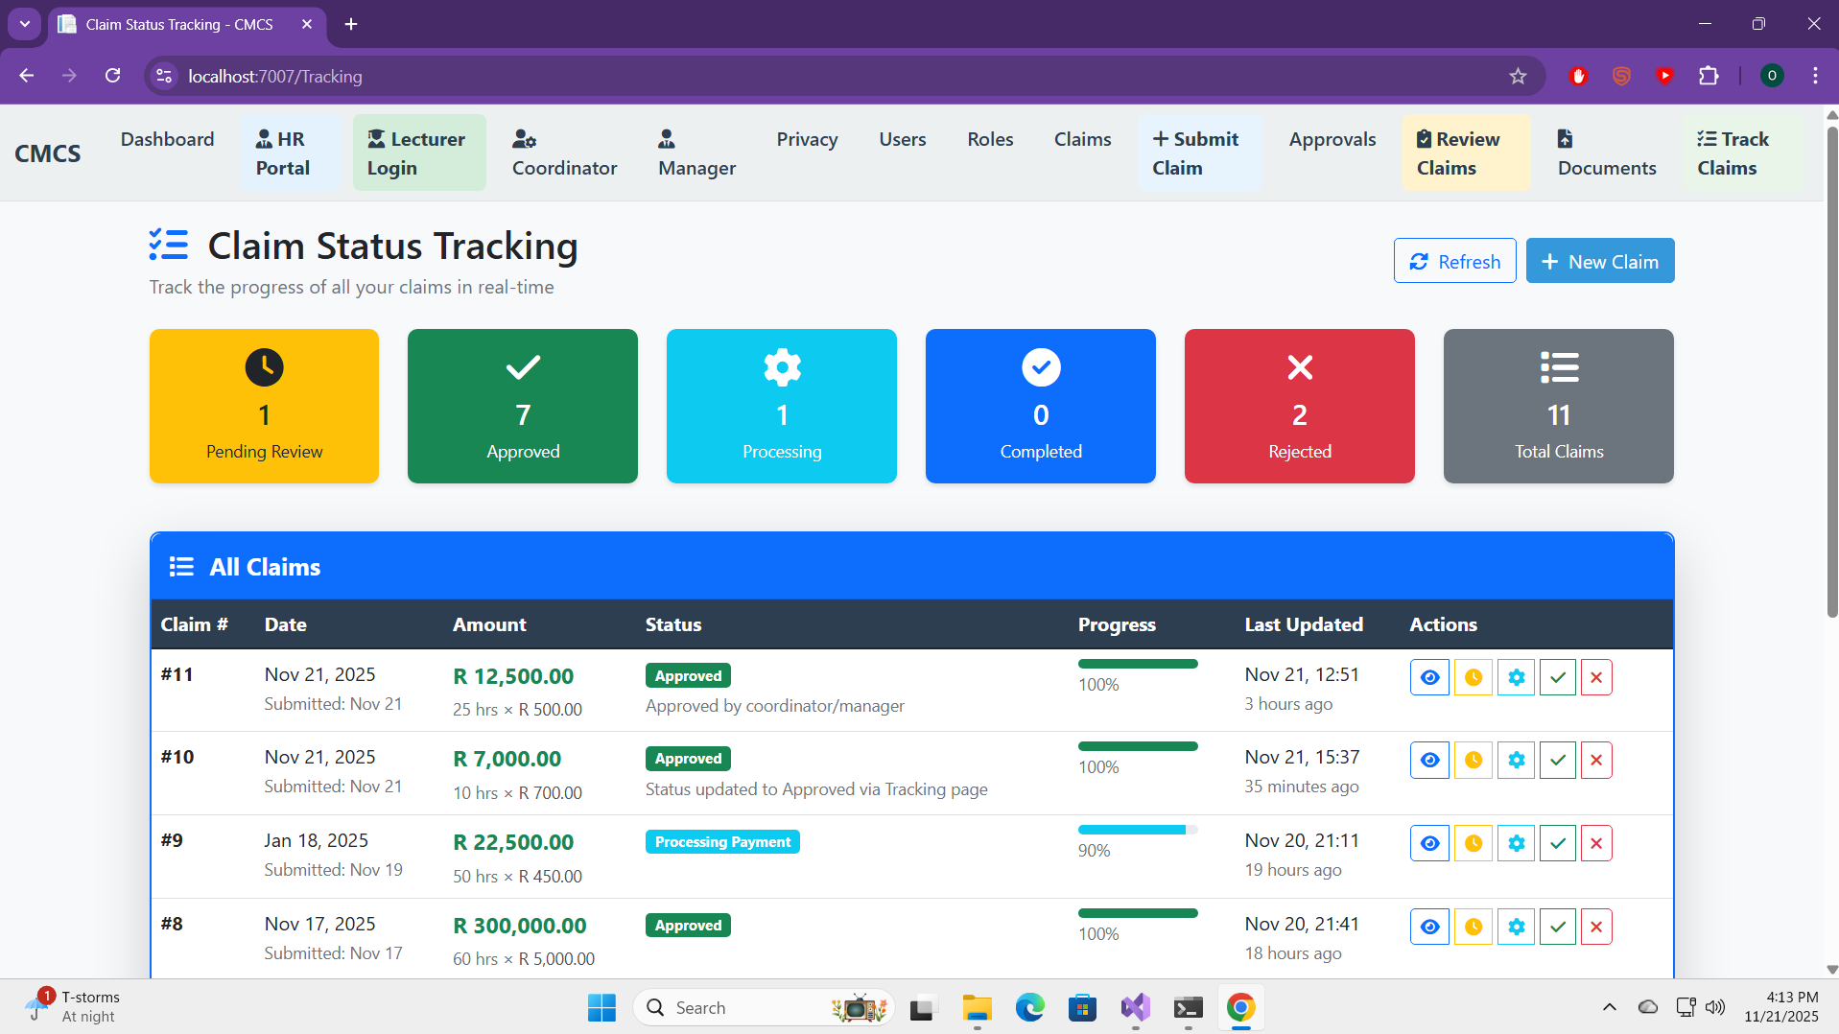
Addressing Part 2 Feedback
Feedback 3: Claim status tracking (8/10) → ENHANCED
After:

Slide 7
Addressing Part 2 Feedback
Feedback 4: Lecturer submission (17/20) → ENHANCED
Feedback 5: Coordinator/Manager views (17/20) → IMPROVED

Slide 8
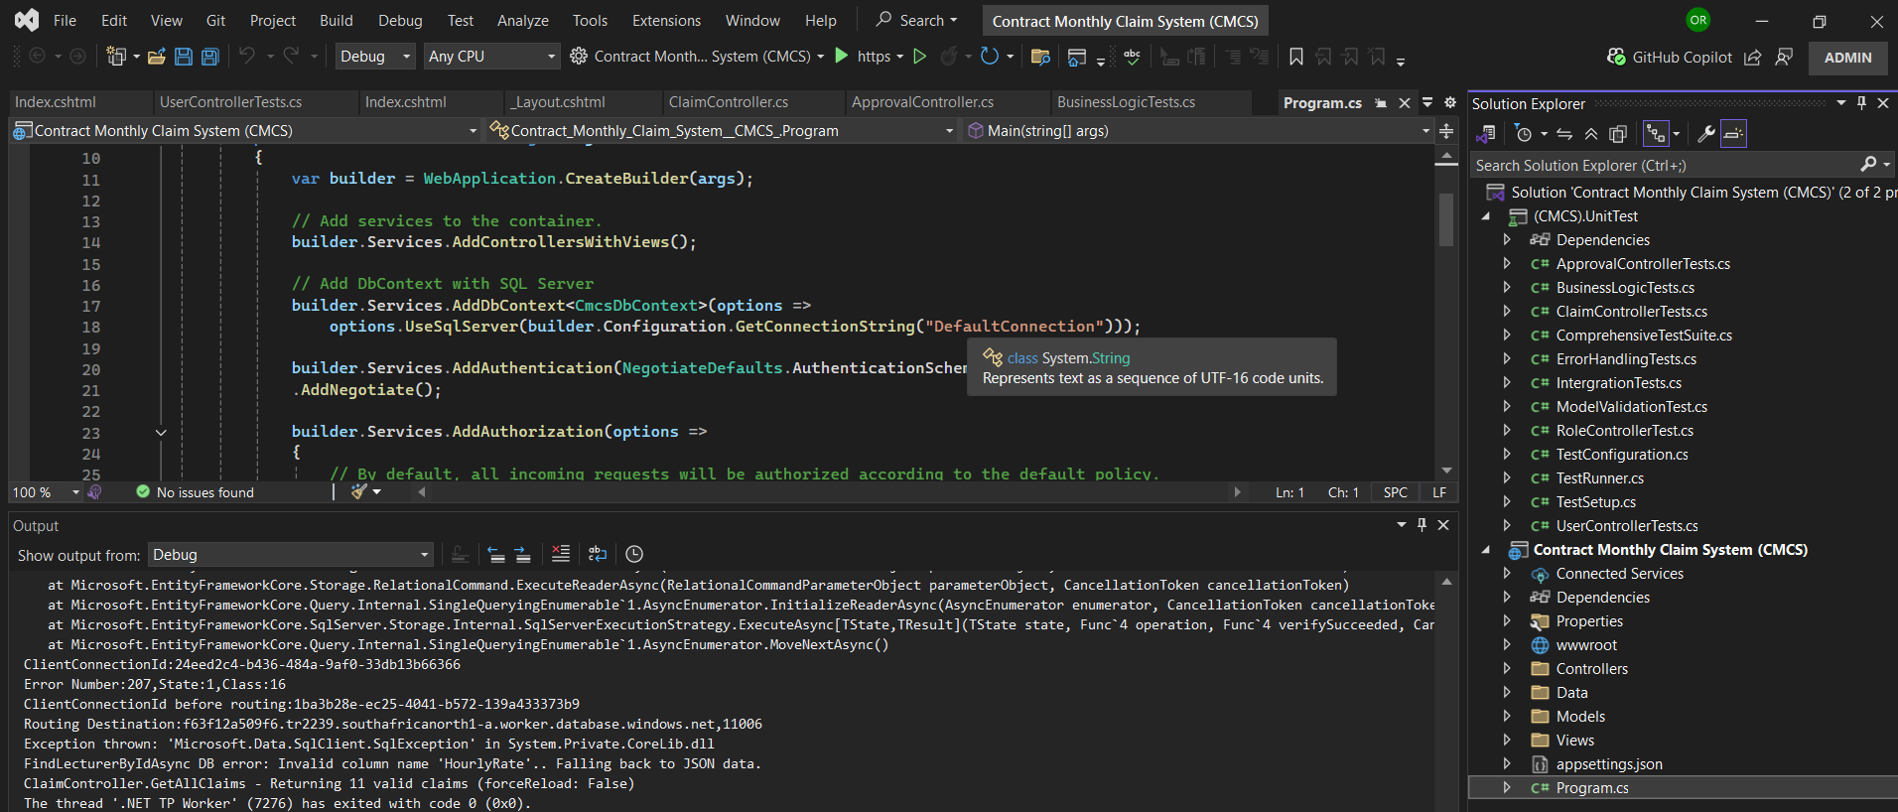
Database Integration (SQL Server)
Migration from JSON files to SQL Server
Entity Framework Core integration
Automatic database creation on startup
JSON fallback mechanism for reliability
Program.cs - DbContext registration:

Slide 9
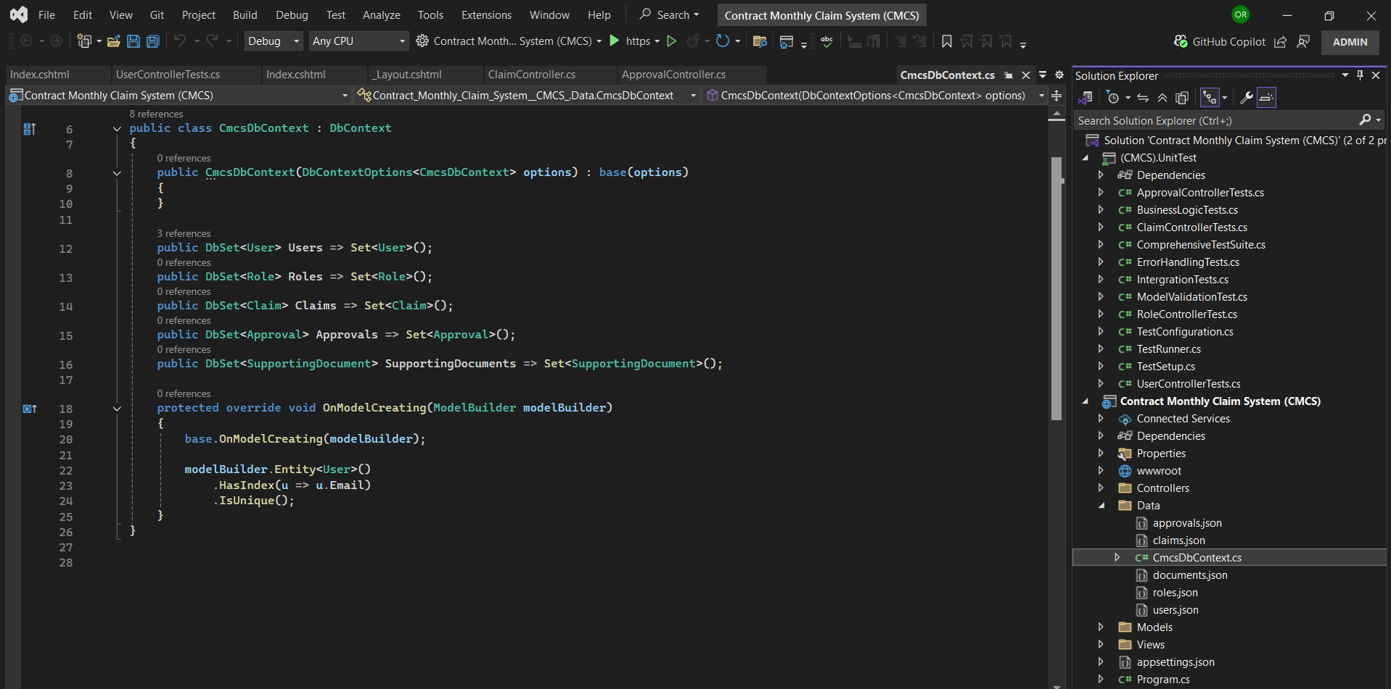
Database Integration (SQL Server)
CmcsDbContext.cs - Entity Framework setup

Slide 10
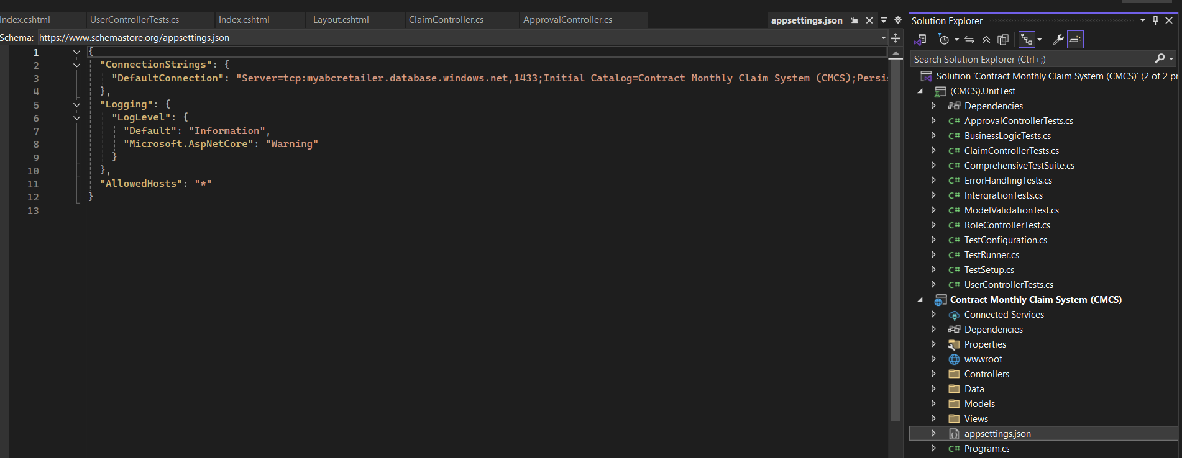
Database Integration (SQL Server)
appsettings.json - Connection string configuration

Slide 11
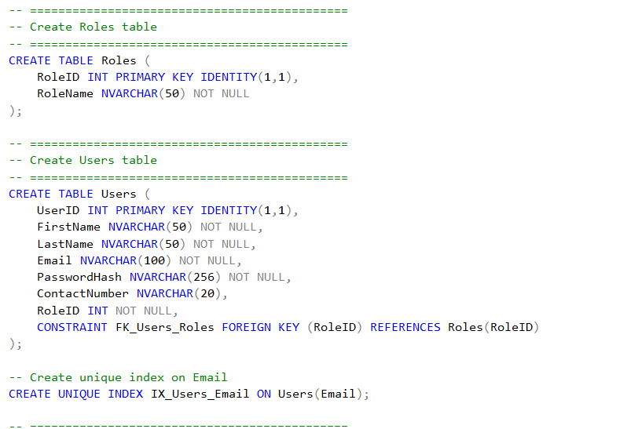
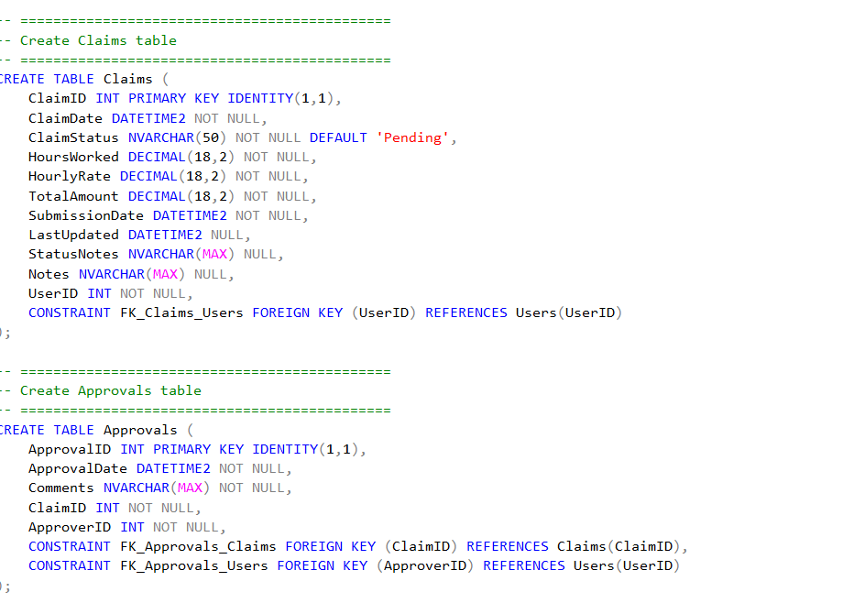
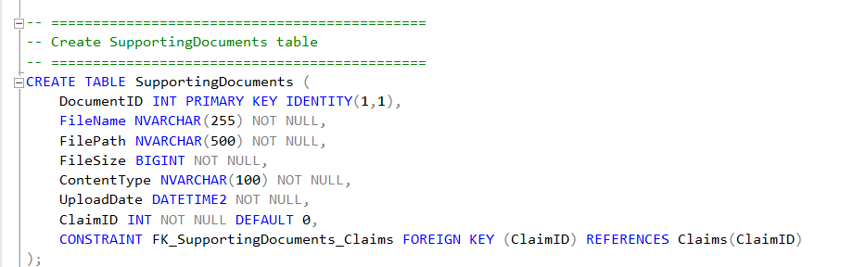
Database Integration (SQL Server)
CMCS.sql - Database schema (CREATE TABLE statements)

Slide 12
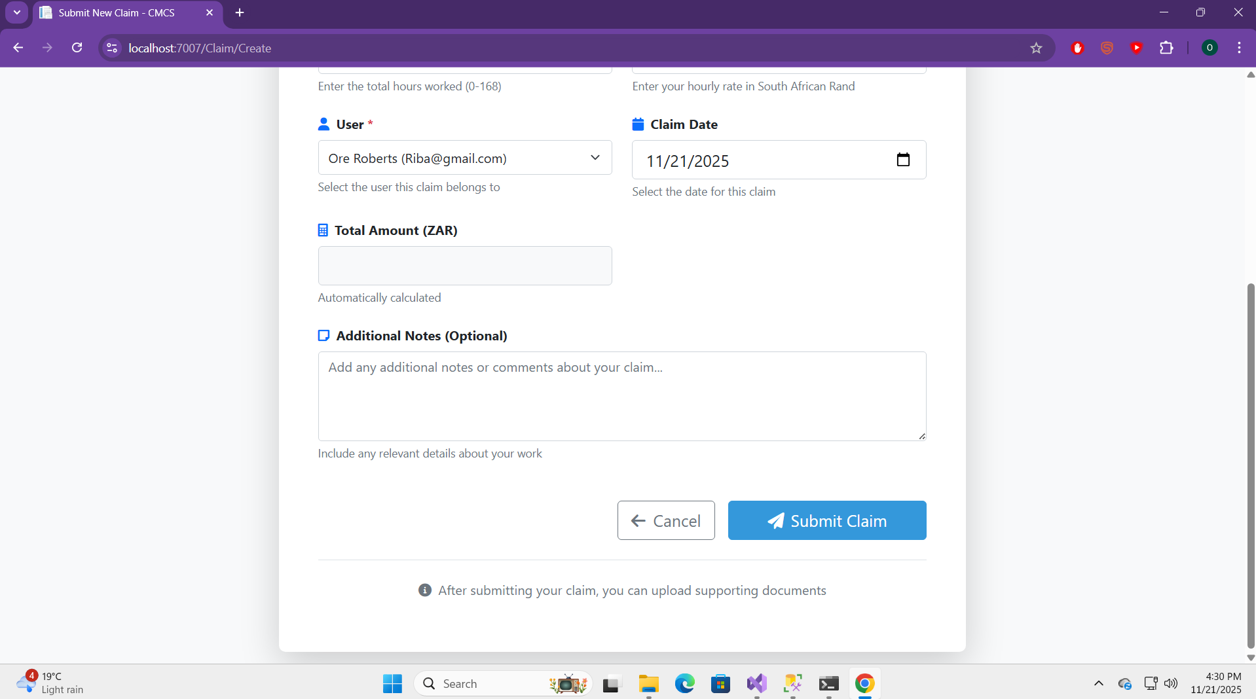
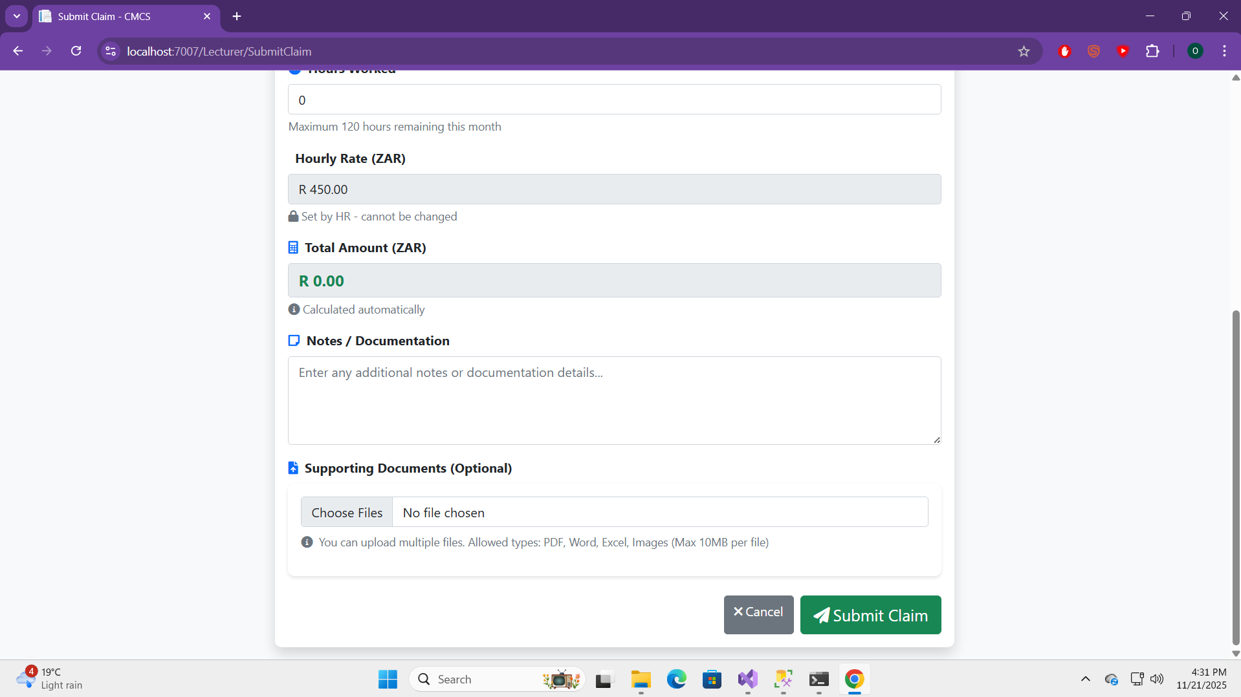
Document Upload Integration (Critical Fix)
BEFORE: Separate page for document upload
AFTER: Integrated directly into claim submission form
Multiple file uploads in one submission
Automatic linking to created claim
Real-time file preview

Slide 13
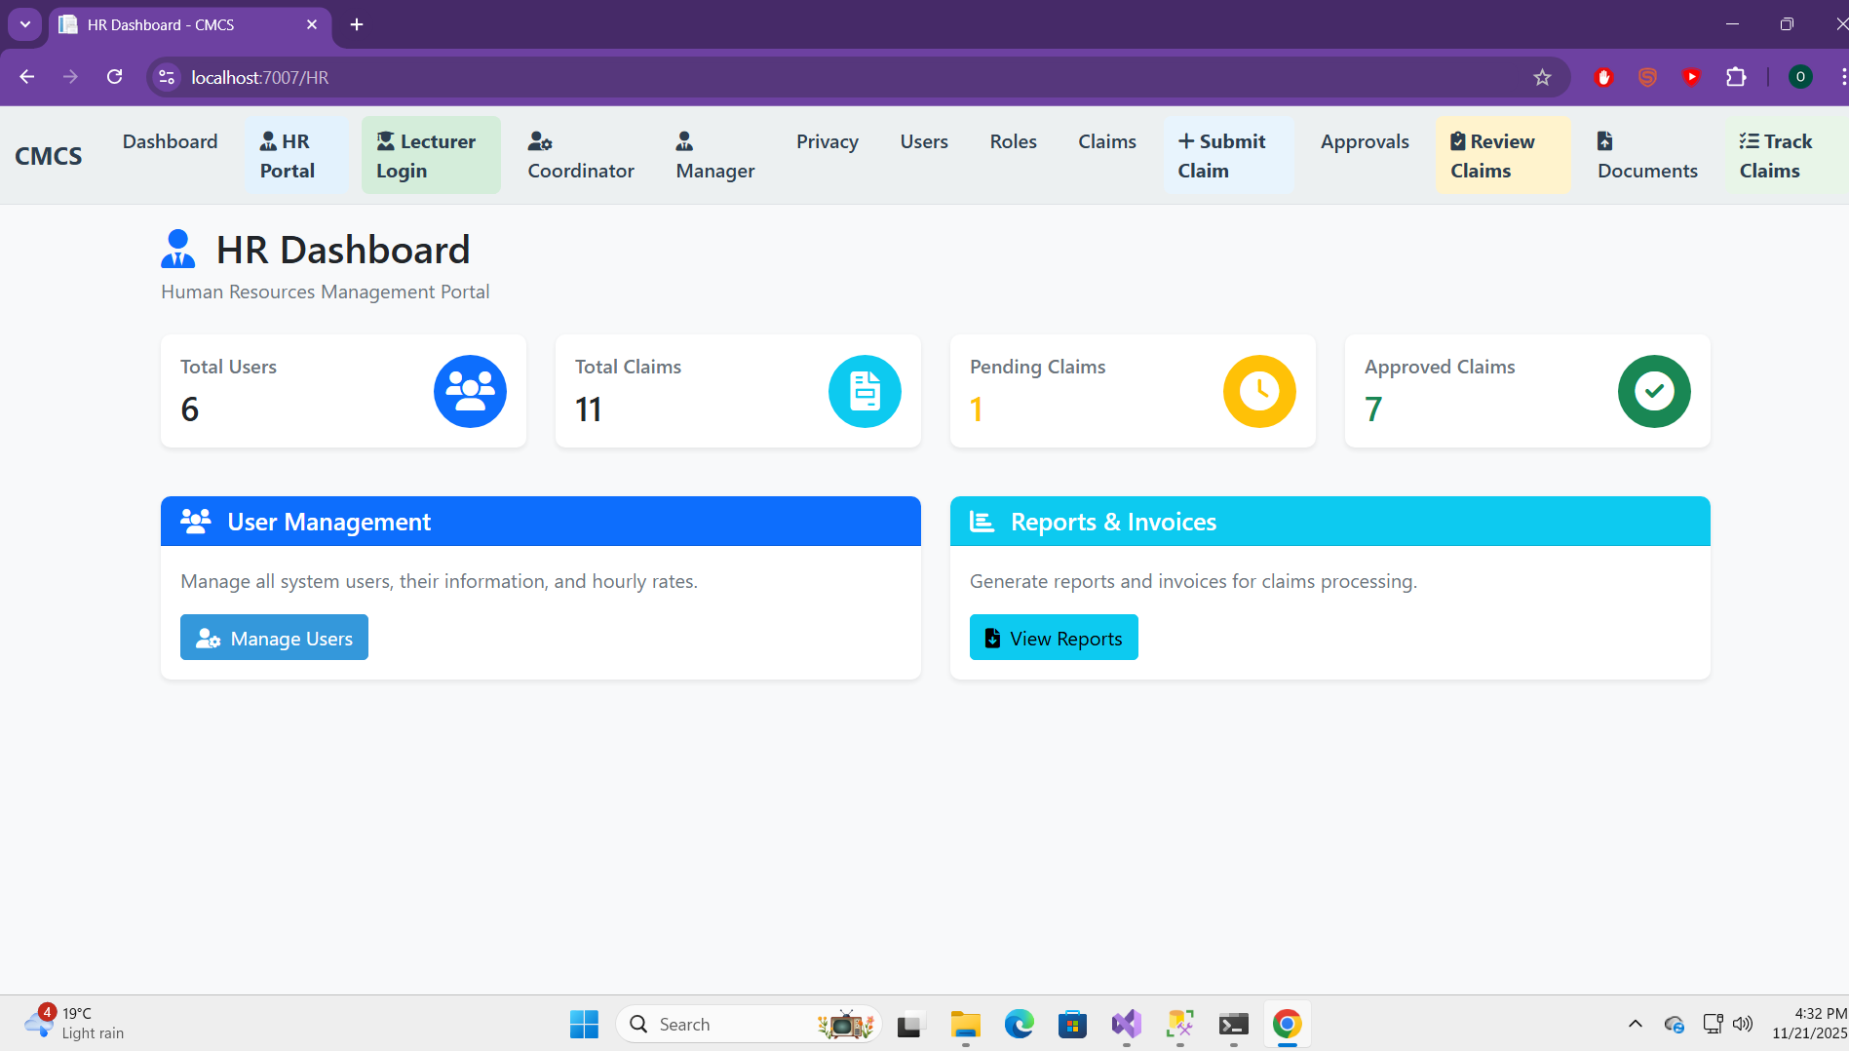
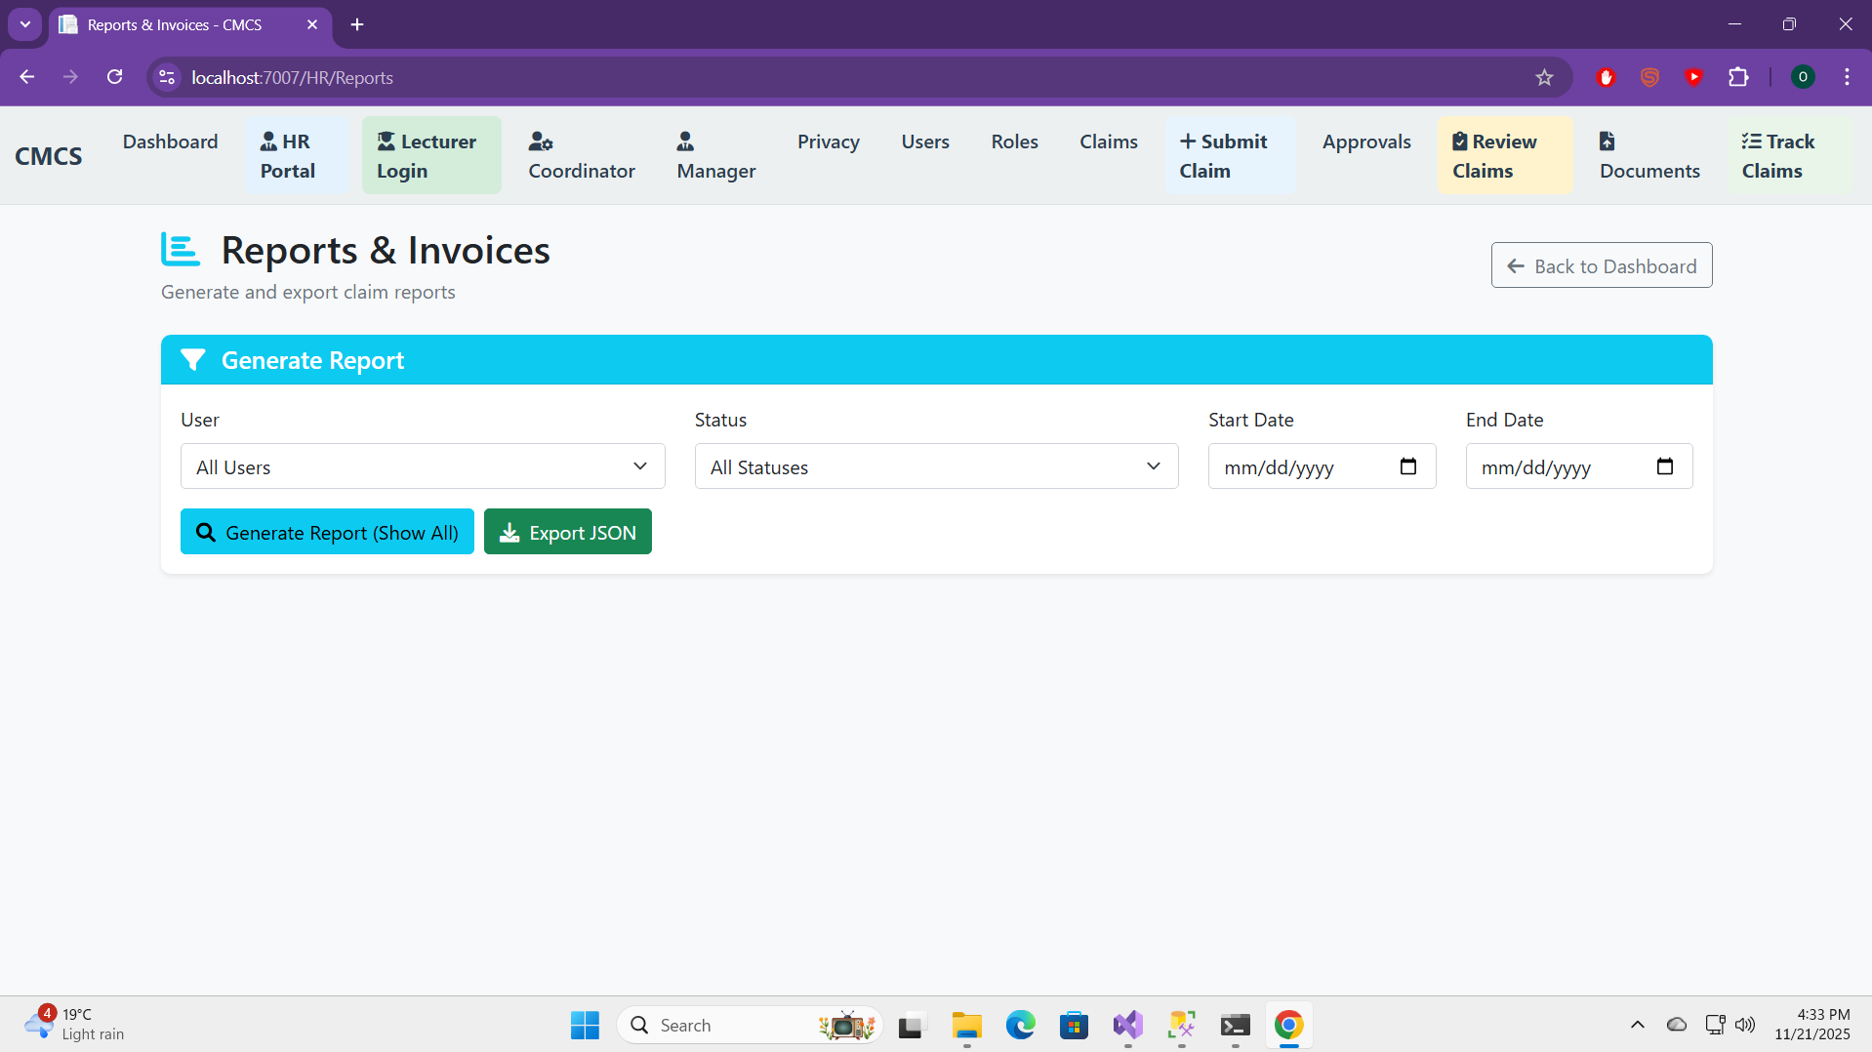
HR Portal Implementation
Report generation with multiple filters
User-claim relationship in reports
Export functionality (JSON)
Clickable links for navigation

Slide 14
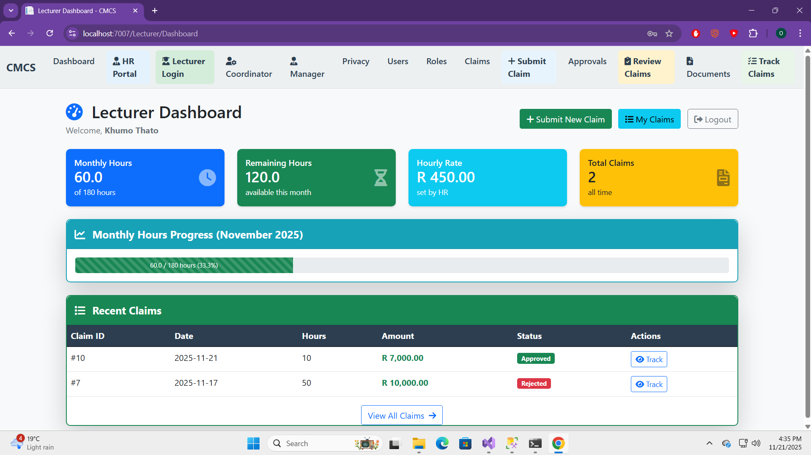
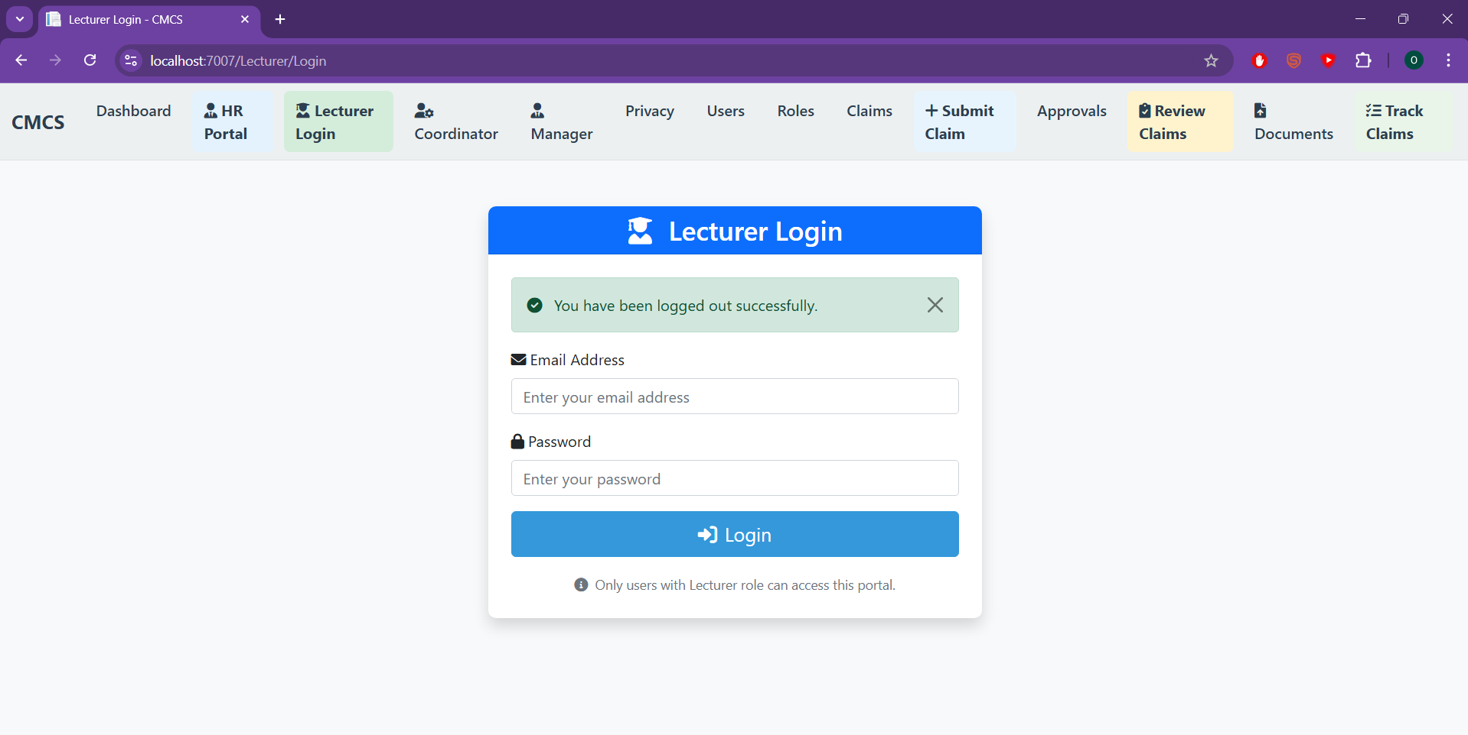
Lecturer View - Complete Implementation
Session-based authentication
Monthly hours tracking (180-hour limit)
Auto-populated lecturer data
Real-time total calculation
Integrated document upload (key improvement)

Slide 15
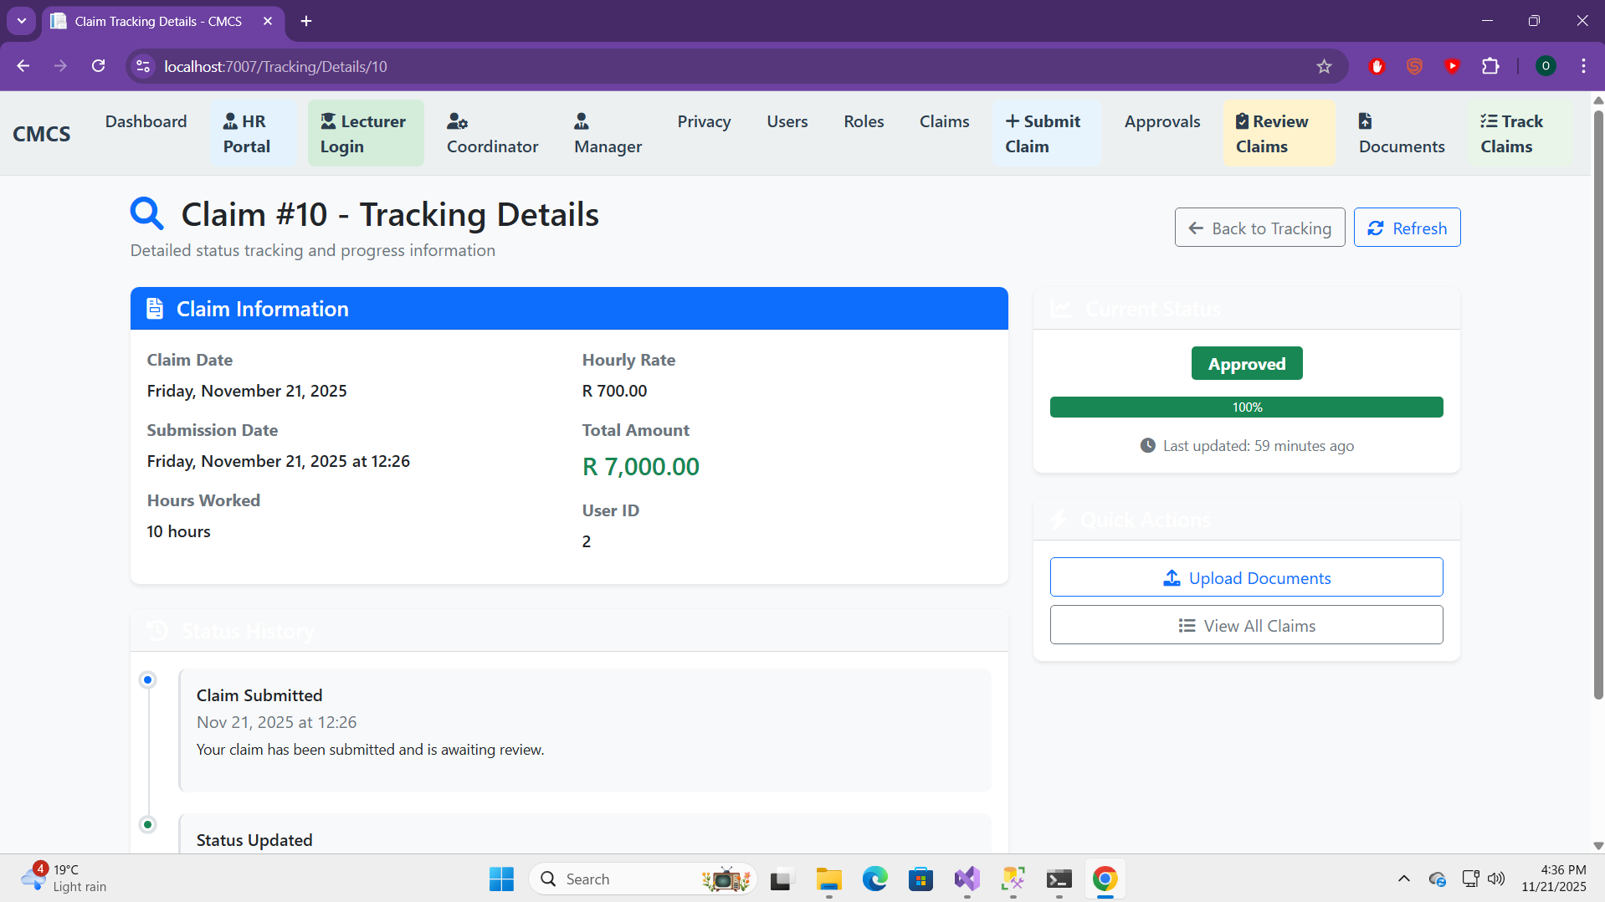
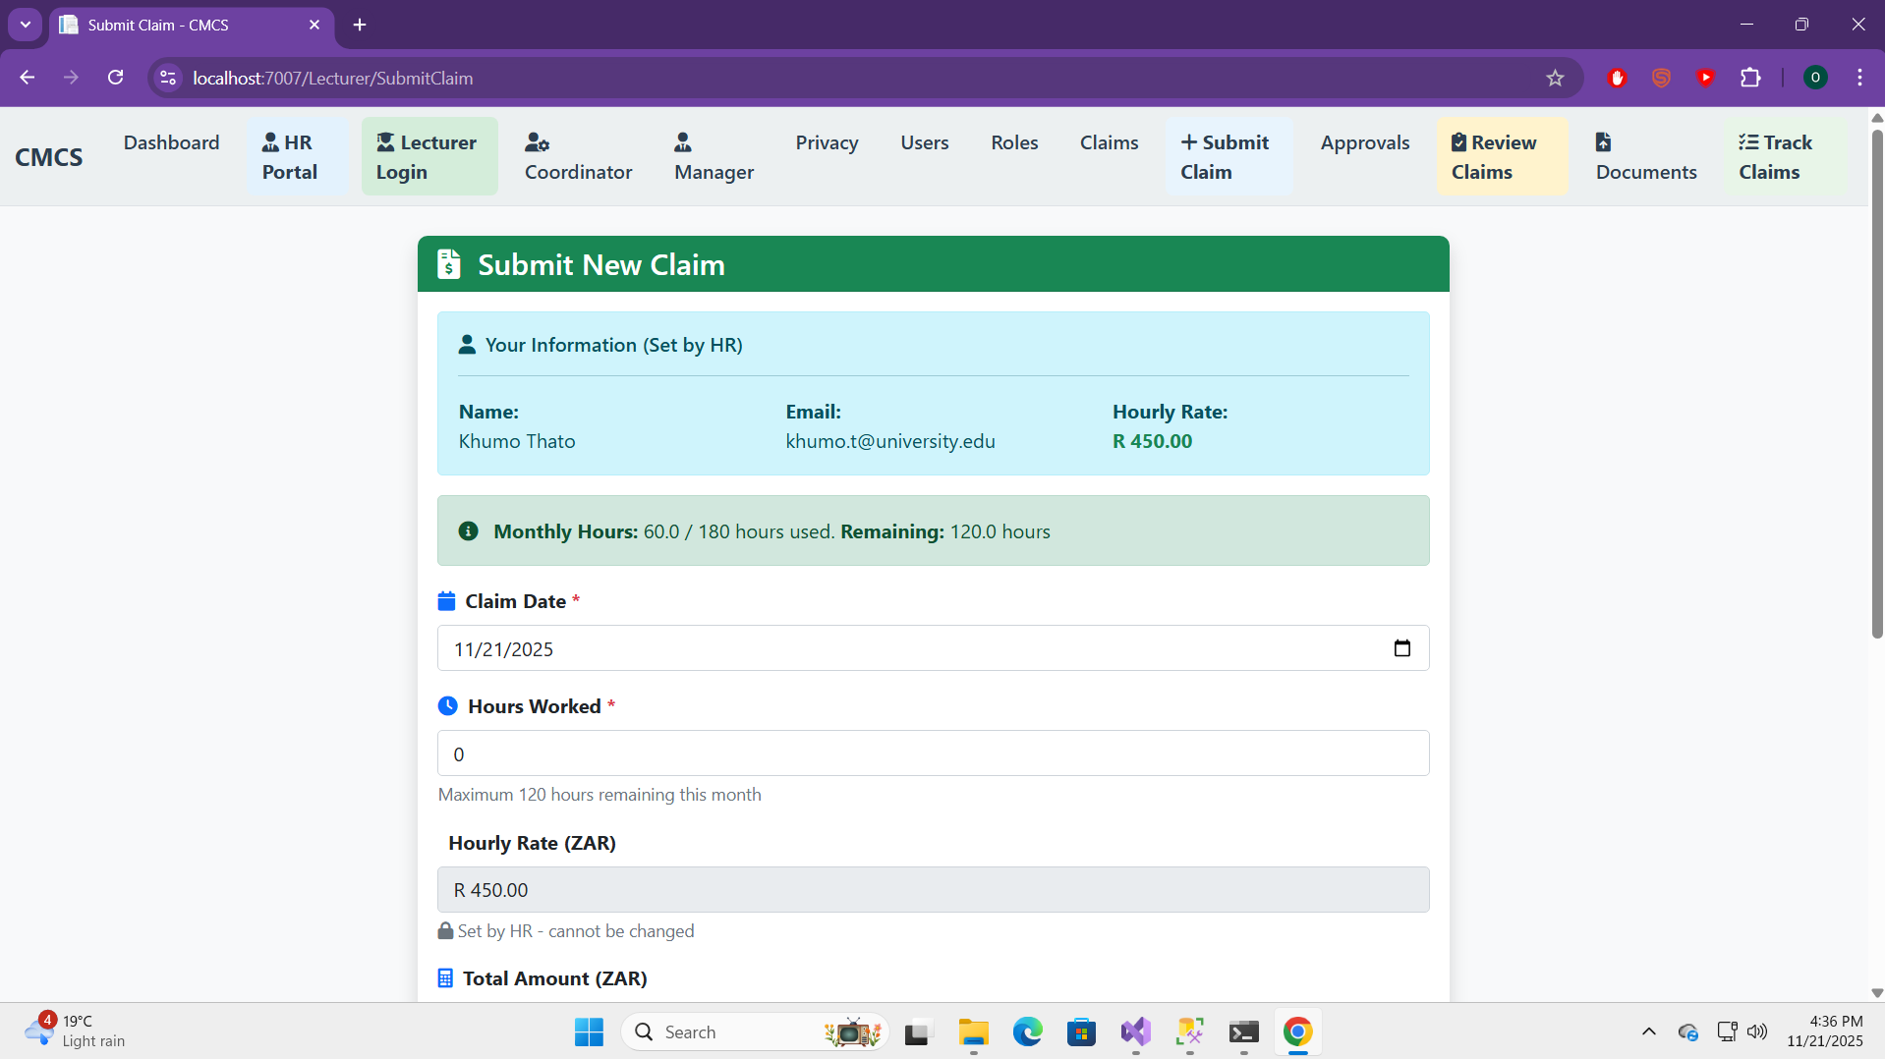

Slide 16
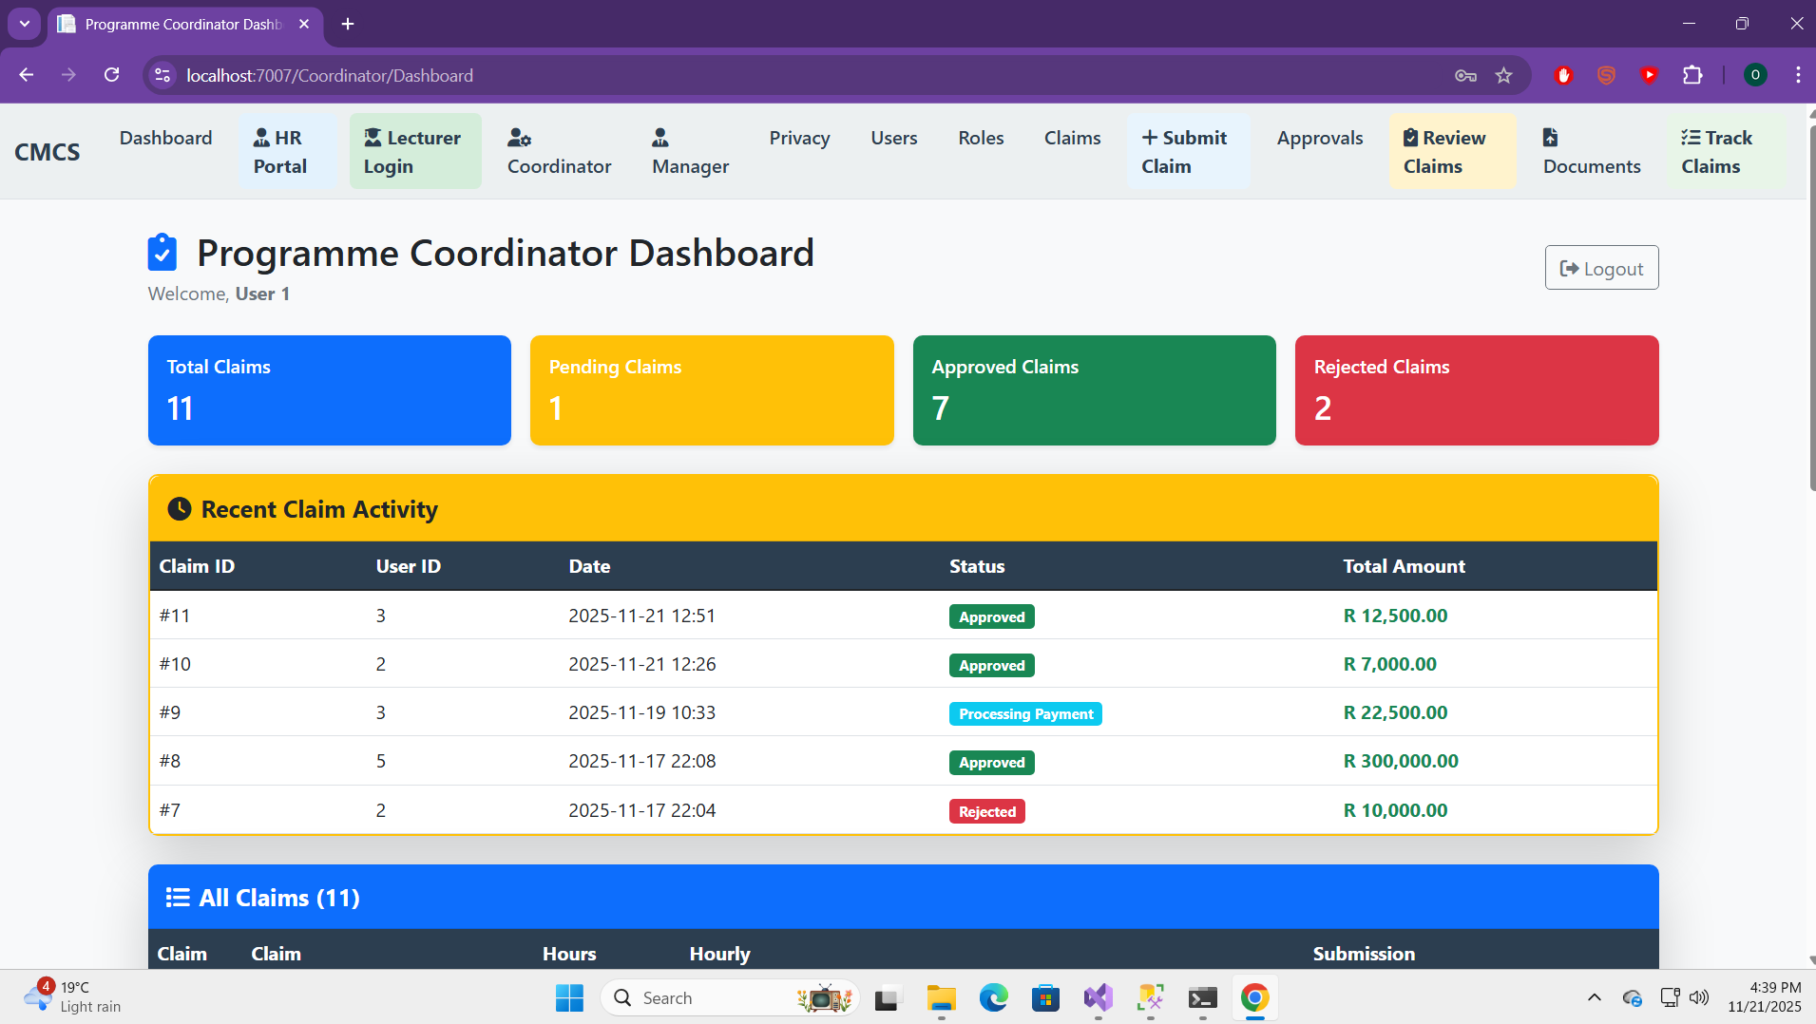
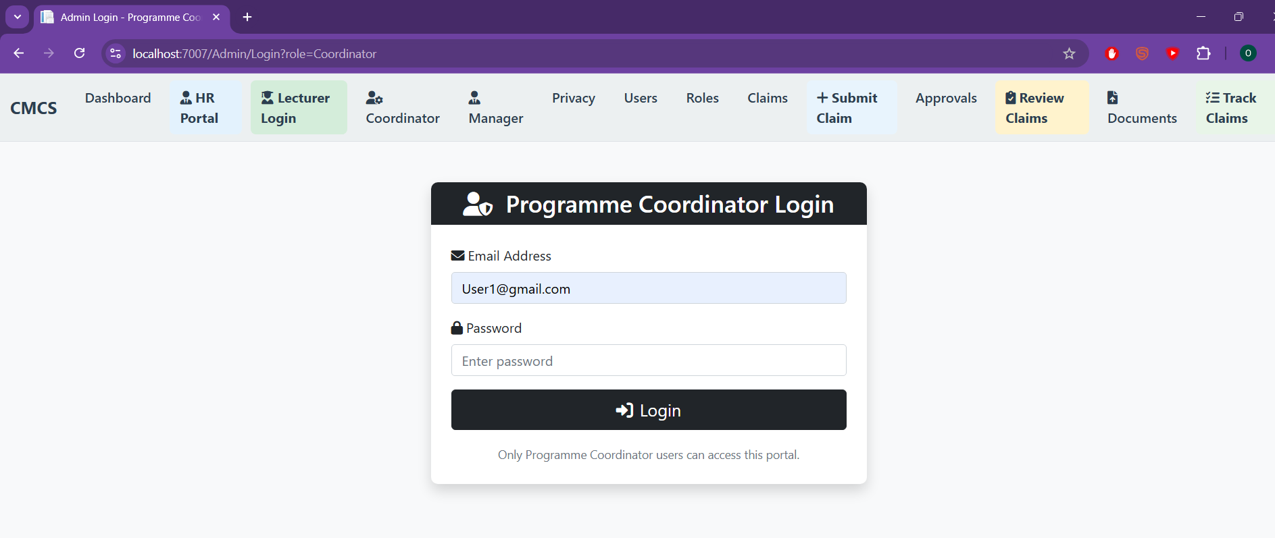
Coordinator & Manager Views
Unified login for both roles
Session-based access control
Comprehensive claim tables
Real-time statistics
Enhanced visibility with colored sections

Slide 17
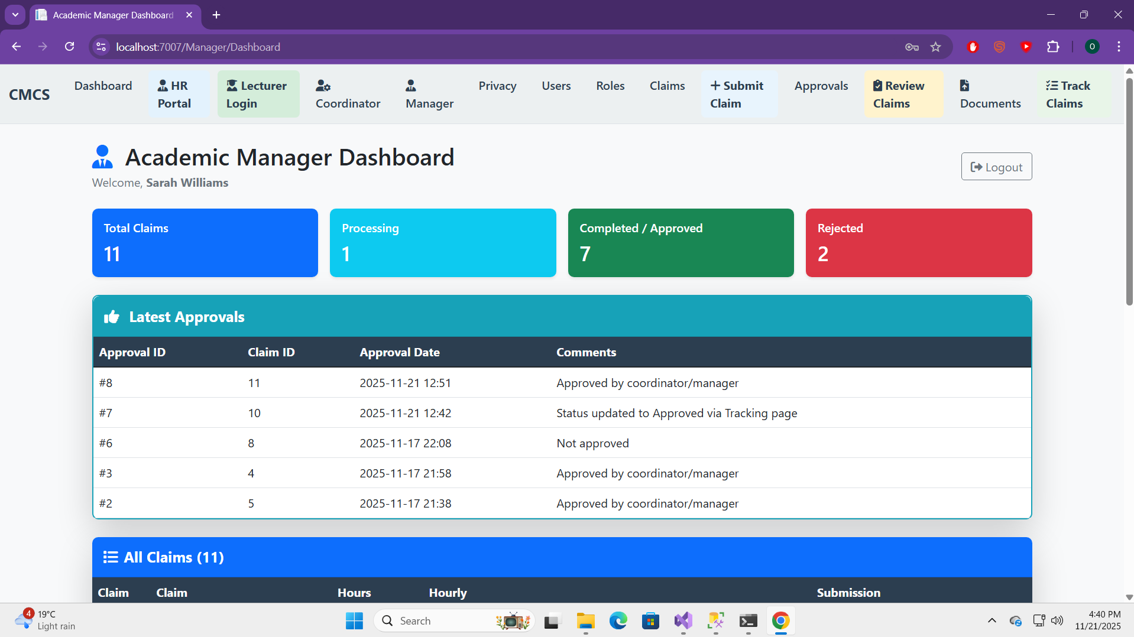
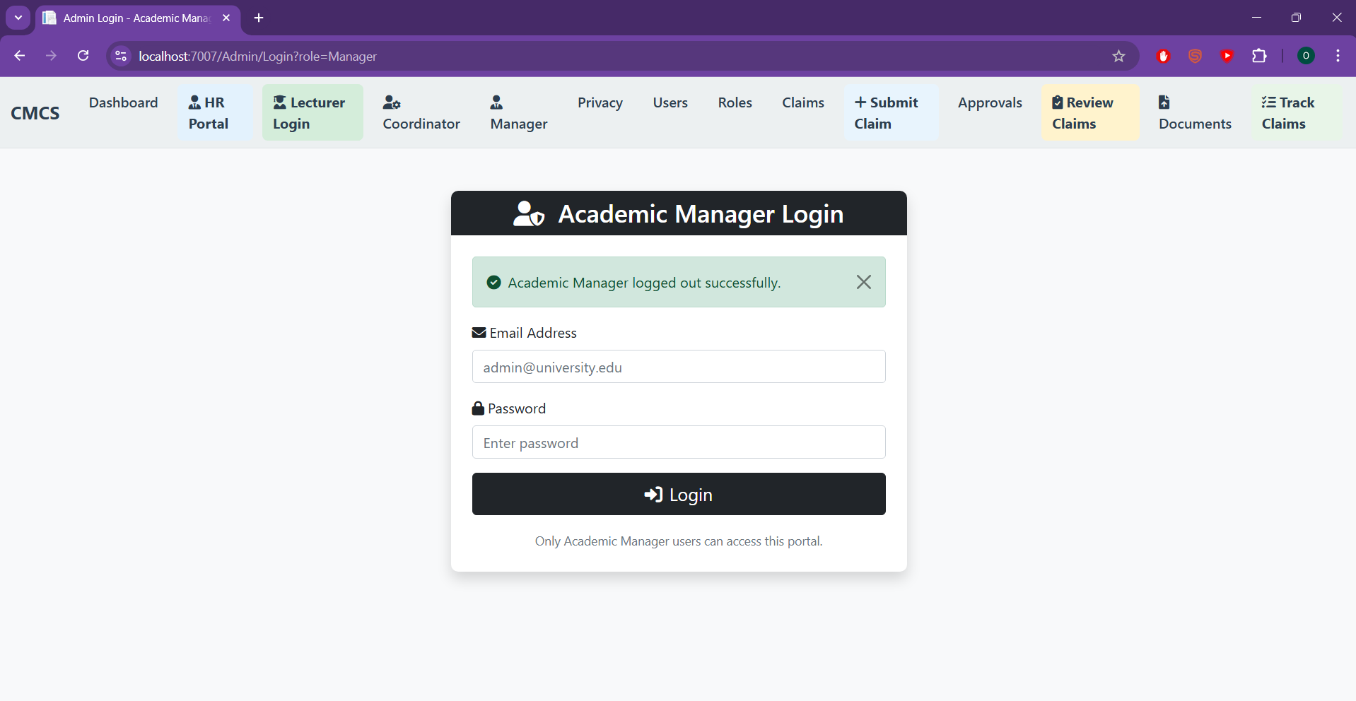

Slide 18
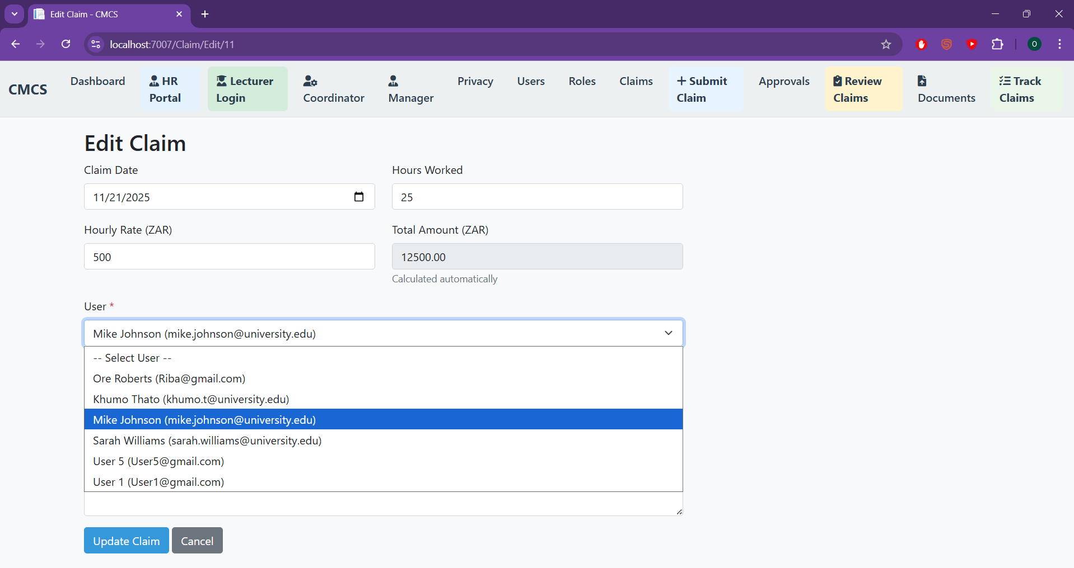
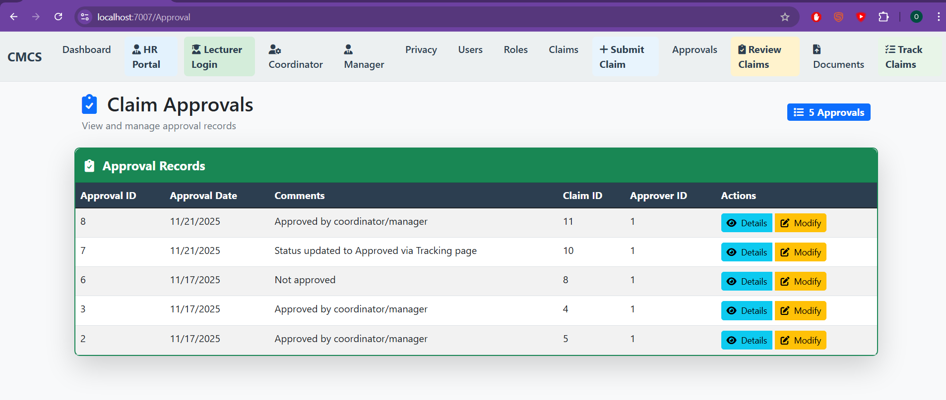
Data Persistence & Synchronization
Data synchronization across controllers
Force reload for latest data
Real-time updates via AJAX
Validation to prevent orphaned records
File persistence with JSON fallback

Slide 19
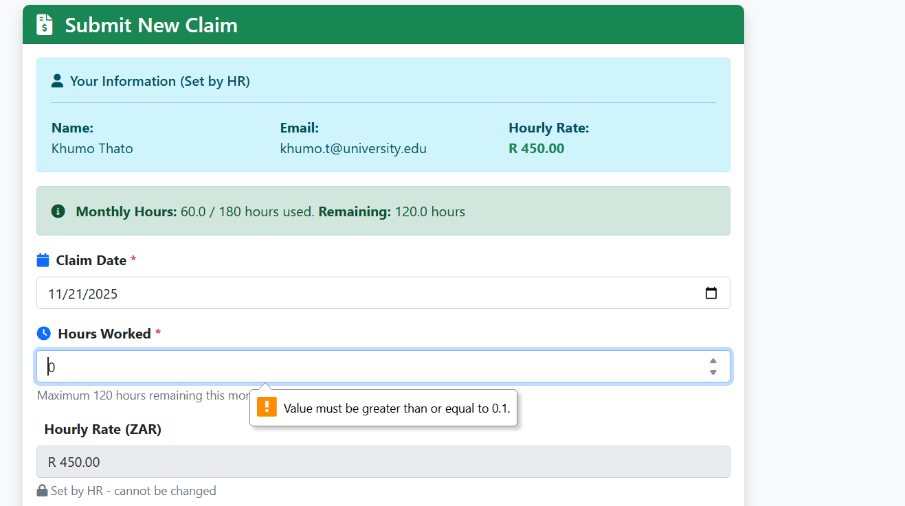
Error Handling Improvements
Comprehensive try-catch blocks
Specific error messages for different scenarios
Client-side validation
User-friendly error display
Debug logging for troubleshooting

Slide 20
Key Features Summary
Role-based dashboards
Integrated document upload
Real-time data updates
Improved user experience
Comprehensive claim management

Slide 21
Improvements Summary
Feature | Part 2 | Part 3 | Improvement
Document Upload | Separate page | Integrated in form | ✅ Critical fix
Error Handling | Basic (8/10) | Enhanced (10/10) | ✅ Comprehensive
Status Tracking | Manual (8/10) | Enhanced (10/10) | ✅ Better UX
Lecturer View | Basic (17/20) | Complete (20/20) | ✅ Full implementation
Coordinator/Manager | Basic (17/20) | Enhanced (20/20) | ✅ Improved visibility
Database | JSON only | SQL Server + JSON | ✅ Production-ready

Slide 22
Code Quality & Best Practices
Consistent error handling
Input validation
Security practices (anti-forgery tokens)
Code organization
Debug logging

Slide 23
Testing & Validation
Manual testing of all features
Validation of feedback fixes
Cross-browser compatibility
Error scenario testing
User flow testing

Slide 24
Future Enhancements
Real-time status updates (SignalR)
Advanced filtering and search
Bulk operations
Email notifications
Mobile responsiveness improvements

Slide 25
Conclusion
All Part 2 feedback addressed
Critical document upload integration completed
Enhanced user experience
Production-ready features
Improved code quality

